Slide 1
Chapter 2: Cryptography Basics 2.3. Elliptic Curve Cryptography
Dr. Xun Yi
Room 14-11-21
Tel: 99251902
Email: xun.yi@rmit.edu.au

Slide 2
Outline
Elliptic Curves over R
Elliptic Curves over GF(p)
Computing Point Multiples on Elliptic Curves
ECDLP
ECDSA

Slide 3
Elliptic curves over R
Definition Let
Example:

Slide 4
Group Operation +
The point of infinity, O, will be the identity element Given

Slide 5
Group operation +
Given Compute
Addition
Doubling

Slide 6
Example (addition):
Given

Slide 7
Example (doubling)
Given

Slide 8
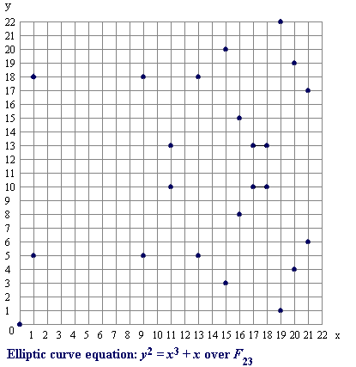
Elliptic Curves over GF(p)
Definition Let
Example:

Slide 9
Galois Field GF(p)
p is a prime number
Example: GF(11)={0,1,2,3,4,5,6,7,8,9,10}
13 (mod 11) = 2, 13=24=35=2 (mod 11)
8+9=17=6 (mod 11)
8-9= -1 =10 (mod 11)
3x4=12=1 (mod 11)
¾=3x4⁻¹=3x3=9 (mod 11)
Multiplicative inverse:
(1,1), (2,6),(3,4),(5,9),(7,8)

Slide 10
Example
Find all (x, y) and O:
Fix x and determine y
O is an artificial point
12 (x, y) pairs plus O,
and have #E=13

Slide 11
Example (continue)
There are 13 points on the group E(Z₁₁) and so any non-identity point (i.e. not the point at infinity, noted as O) is a generator of E(Z₁₁). Choose generator Compute

Slide 12
Example (continue)
Compute So, we can compute

Slide 13
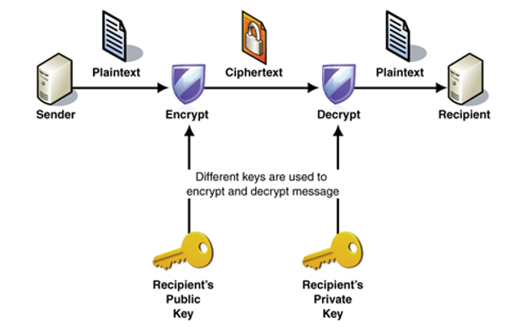
Public Key Encryption

Slide 14
Example (continue)
Let’s modify ElGamal encryption by using the elliptic curve E(Z₁₁). Suppose that and Bob’s private key is x=7, the public key is The encryption operation is where and , and the decryption operation is

Slide 15
Example (continue)
Suppose that Alice wishes to encrypt the plaintext m = (10,9) (which is a point on E). If she chooses the random value k = 3, then Hence . Now, if Bob receives the ciphertext c, he decrypts it as follows:

Slide 16
Computing Point Multiples on Elliptic Curves
Use Double-and-Add (similar to square-and-multiply) Algorithm: DOUBLE-AND-ADD

Slide 17
Example
Compute 7P
7P=(2²+2+1)P=2(2P+P)+P
2 doublings and 2 additions instead of 7 additions

Slide 18
Example
Compute 3895P

Slide 19
Elliptic Curve DLP
Basic computation of ECC
Q = kP =
where P is a curve point, k is an integer
Strength of ECC
Given curve, the point P, and kP
It is hard to recover k
- Elliptic Curve Discrete Logarithm Problem (ECDLP)

Slide 20
Signature Scheme: ECDSA
Digital Signature Algorithm (DSA)
Proposed in 1991
Was adopted as a standard on December 1, 1994
Elliptic Curve DSA (ECDSA)
FIPS 186-2 in 2000

Slide 21
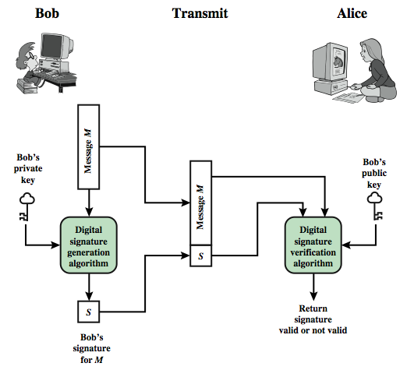
Digital Signature Model
Notes:
Diffie-Hellman public key cryptography.
This is a generic model of the process of making and using digital signatures. Bob can sign a message using a digital signature generation algorithm. The inputs to the algorithm are the message and Bob's private key. Any other user, say Alice, can verify the signature using a verification algorithm, whose inputs are the message, the signature, and Bob's public key.

Slide 22
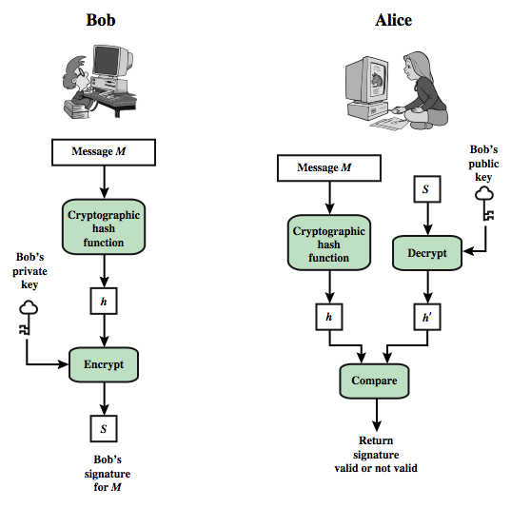
Cont.

Slide 23
Elliptic Curve DSA
Let p be a prime, and let E be an elliptic curve defined over GF(p). Let A be a point on E having prime order q, such that DL problem in <A> is infeasible.
Define K={ (p, q, E, A, x, Y): Y=xA }
p, q, E, A,Y are the public key, x is private

Slide 24
ECDSA
For a (secret) random number k, define sig_{x}(m,k)=(r,s),
where kA=(u,v), r=u mod q and
s=k⁻¹(Hash(m)+xr) mod q
For a message (m,(r,s)), verification is done by performing the following computations:
i=Hash(m) • s⁻¹ mod q
j=r•s⁻¹ mod q
(u,v)=iA+jY
ver(m,(r,s))=true if and only if u mod q=r

Slide 25
Elliptic Curve Security
Symmetric Key Size (bits) | RSA and Diffie-Hellman Key Size (bits) | Elliptic Curve Key Size (bits)
80 | 1024 | 160
112 | 2048 | 224
128 | 3072 | 256
192 | 7680 | 384
256 | 15360 | 521
NIST Recommended Key Sizes

Slide 26
Security of ECC versus RSA/ElGamal
Elliptic curve cryptosystems give the most security per bit of any known public-key scheme.
The ECDLP problem appears to be much more difficult than the integer factorisation problem and the discrete logarithm problem of Z_{p}.
The strength of elliptic curve cryptosystems grows much faster with the key size increases than does the strength of RSA.

Slide 27
RSA
by Rivest, Shamir & Adleman of MIT in 1977
best known & widely used public-key scheme
http://www.ams.org/notices/200307/comm-turing.pdf
Notes:
RSA is the best known, and by far the most widely used general public key encryption algorithm, and was first published by Rivest, Shamir & Adleman of MIT in 1978 [RIVE78]. The Rivest-Shamir-Adleman (RSA) scheme has since that time reigned supreme as the most widely accepted and implemented general-purpose approach to public-key encryption. It is based on exponentiation in a finite (Galois) field over integers modulo a prime, using large integers (eg. 1024 bits). Its security is due to the cost of factoring large numbers.

Slide 28
RSA En/decryption
to encrypt a message M the sender:
obtains public key of recipient PU={e,n}
computes: C = Me mod n, where 0≤M<n
to decrypt the ciphertext C the owner:
uses their private key PR={d,n}
computes: M = C^{d} mod n
note that the message M must be smaller than the modulus n (block if needed)
Notes:
The scheme developed by Rivest, Shamir, and Adleman makes use of an expression with exponentials. Plaintext is encrypted in blocks, with each block having a binary value less than some number n. The actual RSA encryption and decryption computations are each simply a single exponentiation mod (n). Both sender and receiver must know the value of n. The sender knows the value of e, and only the receiver knows the value of d. Thus, this is a public-key encryption algorithm with a public key of PU = {e, n} and a private key of PR = {d, n}. Note that the message must be smaller than the modulus. The “magic” is in the choice of the modulus and exponents which makes the system work.

Slide 29
RSA Example - Key Setup
Select primes: p=17 & q=11
Calculate n = pq =17 x 11=187
Calculate ø(n)=(p–1)(q-1)=16x10=160
Select e: gcd(e,160)=1; choose e=7
Determine d: de=1 mod 160 and d < 160 Value is d=23 since 23x7=161= 10x160+1
Publish public key PU={7,187}
Keep secret private key PR={23,187}
Notes:
Stallings provides an example of RSA key generation using “trivial” sized numbers.
Selecting primes requires the use of a primality test.
Finding d as inverse of e mod ø(n) requires use of Euclid’s Inverse algorithm (see Ch4)

Slide 30
RSA Example - En/Decryption
sample RSA encryption/decryption is:
given message M = 88 (nb. 88<187)
encryption:
C = 88⁷ mod 187 = 11
decryption:
M = 11²³ mod 187 = 88
Notes:
Then show that the encryption and decryption operations are simple exponentiations mod 187.
Rather than having to laborious repeatedly multiply, can use the "square and multiply" algorithm with modulo reductions to implement all exponentiations quickly and efficiently (see next).

Slide 31
ECC Benefits
ECC is particularly beneficial for application where:
computational power is limited (wireless devices, PC cards)
integrated circuit space is limited (wireless devices, PC cards)
high speed is required.
intensive use of signing, verifying or authenticating is required.
signed messages are required to be stored or transmitted (especially for short messages).
bandwidth is limited (wireless communications and some computer networks).

